Slide 1
Markov Chains Weather Model
By Najia Jahan
CSC 30100
Final Project
Spring 2023

Slide 2
What is Markov Chains?
Markov chains are mathematical models used to describe a sequence of events in which the probability of each event depends only on the state attained in the previous event.
This is known as Memorylessness.
P(X_{n+1} = x | X₁ = x₁, X₂ = x₂ , X₃ = x_{3,….} X_{n} = x_{n})
P(X_{n+1} = x | X_{n+1} = x_{n})

Slide 3
States and Transitions
States: A and B
Possible Transitions: 4 (not 2, because a state can transition back into itself)
If we're at 'A' we could transition to 'B' or stay at 'A'. If we're at 'B' we could transition to 'A' or stay at 'B'.

Slide 4
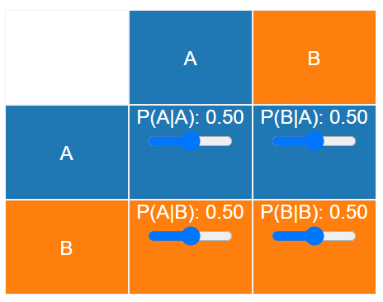
Transition Matrix
Transition Table

Slide 5

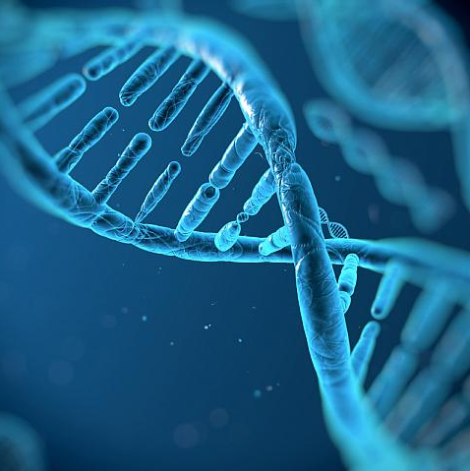
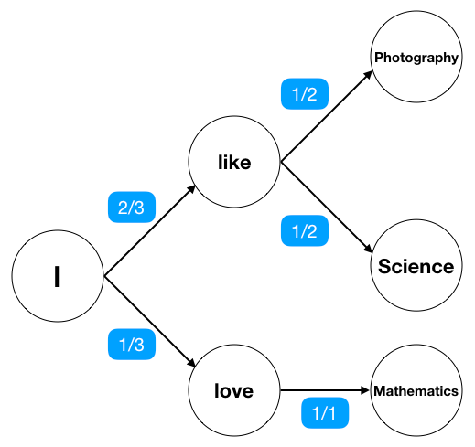
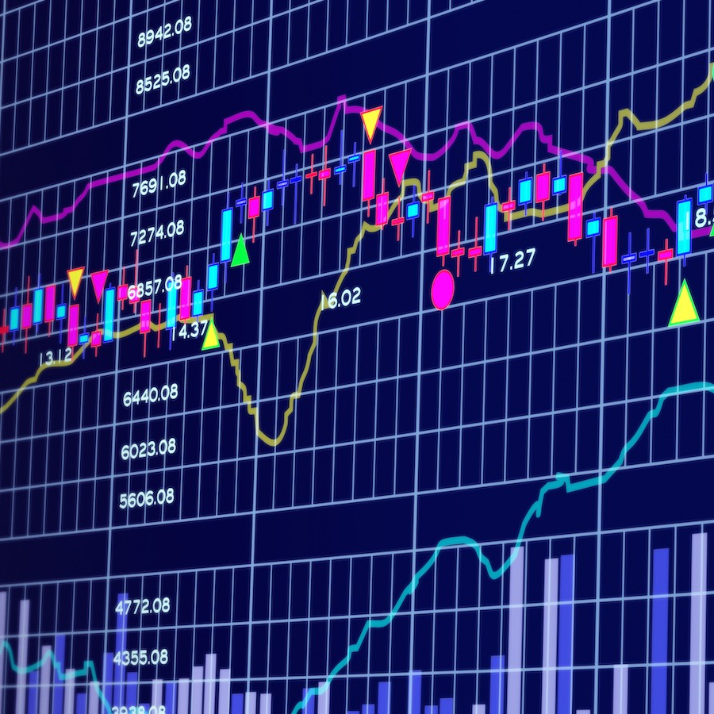
Real life usage
Weather Forecast Prediction
Financial Market Analysis
Speech Recognition
Text Prediction
Genetic Analysis

Slide 6



example
Three States
Sunny
Cloudy
Rainy

Slide 7
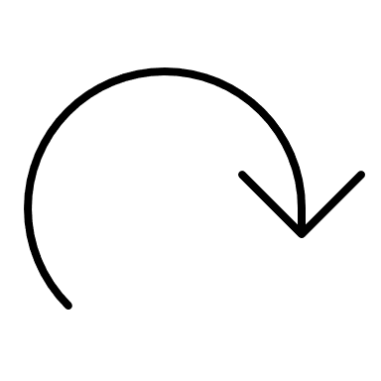
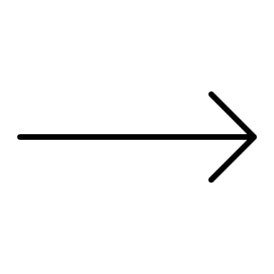
9 Transitions

Slide 8
Days | Weather
Day 1 | Sunny
Day 2 | Cloudy
Day 3 | Rainy
Day 4 | Sunny
Day 5 | Rainy
Day 6 | Cloudy
Day 7 | Sunny
Day 8 | Rainy
Day 9 | Sunny
Day 10 | Sunny
Day 11 | Cloudy
Day 12 | Rainy
Sunny -> Sunny: 1
Sunny -> Cloudy: 2
Sunny -> Rainy: 2
Rainy -> Rainy: 0
Rainy -> Sunny: 2
Rainy -> Cloudy: 1
Cloudy -> Cloudy: 0
Cloudy -> Sunny: 1
Cloudy -> Rainy: 2

Slide 9
counts | Sunny | Rainy | Cloudy
Sunny | 1 | 2 | 2
Rainy | 2 | 0 | 1
Cloudy | 1 | 1 | 0
Sunny -> Sunny: 1
Sunny -> Cloudy: 2
Sunny -> Rainy: 2
Rainy -> Rainy: 0
Rainy -> Sunny: 2
Rainy -> Cloudy: 1
Cloudy -> Cloudy: 0
Cloudy -> Sunny: 1
Cloudy -> Rainy: 2
probabilities | Sunny | Rainy | Cloudy
Sunny | 1/5 = 0.2 | 2/5 = 0.4 | 2/5 = 0.4
Rainy | 2/3 = 0.67 | 0 | 1/3 = 0.33
Cloudy | 1/3 = 0.33 | 2/3 = 0.67 | 0

Slide 10
 | Sunny | Rainy | Cloudy
Sunny | 0.2 | 0.4 | 0.4
Rainy | 0.6 | 0 | 0.3
Cloudy | 0.3 | 0.6 | 0
0.2
0.3
0.6
0.4
0.4
0
0
0.3
0.6

Slide 11
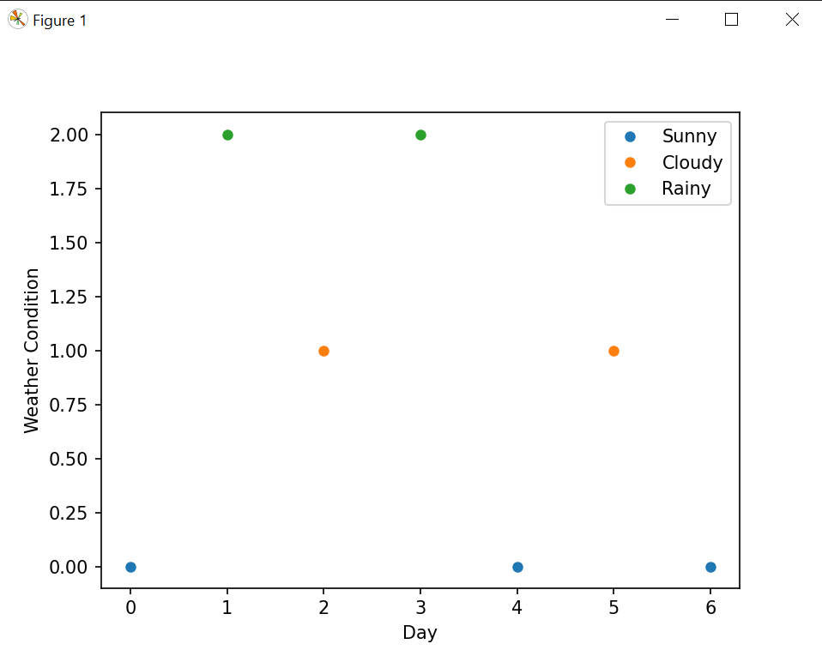
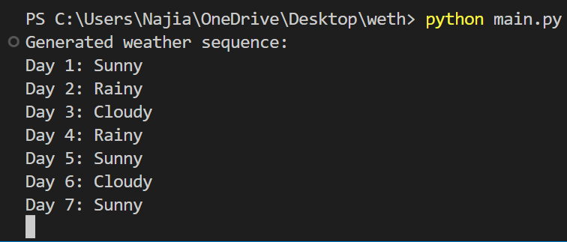

Slide 12
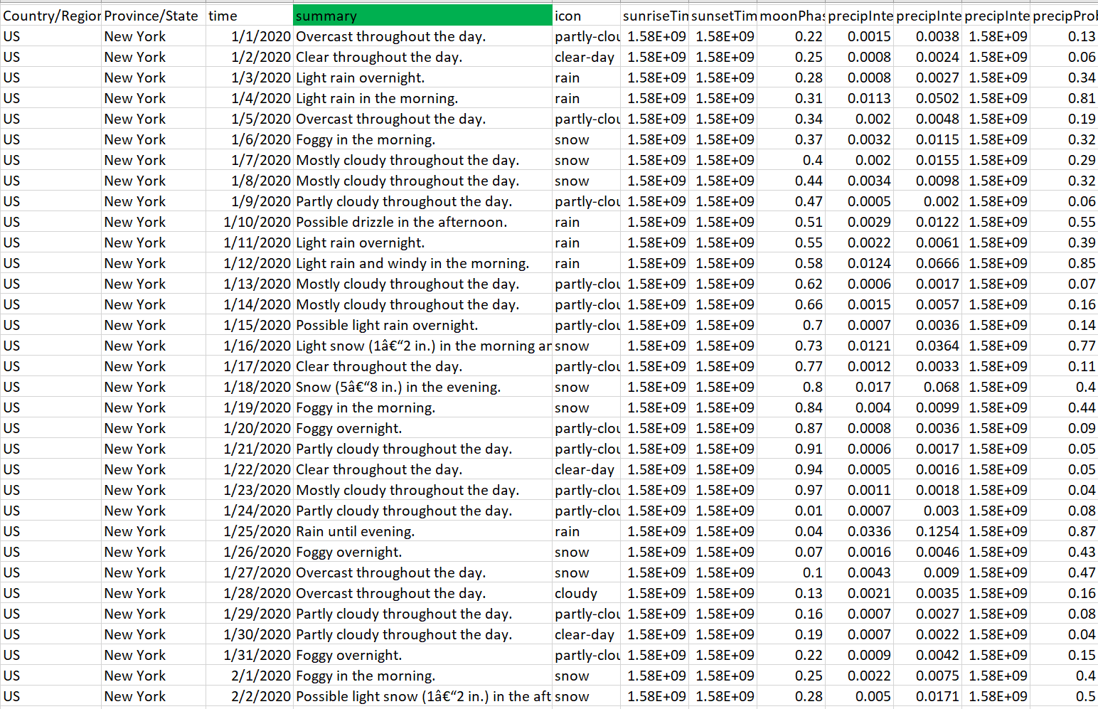
Sample Data Table

Slide 13
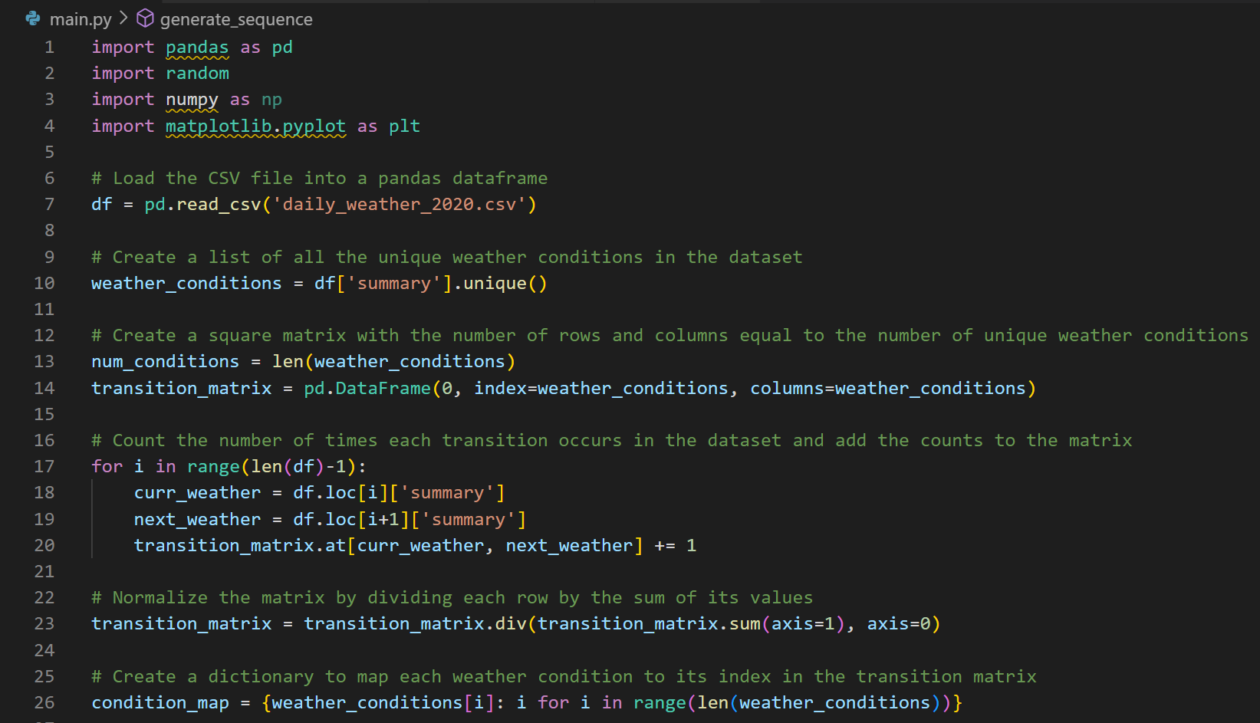

Slide 14
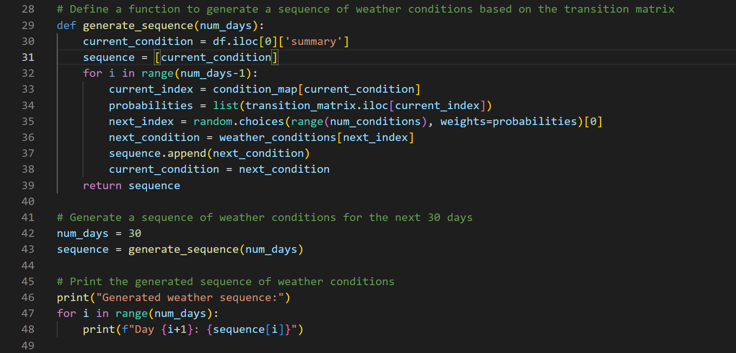

Slide 15
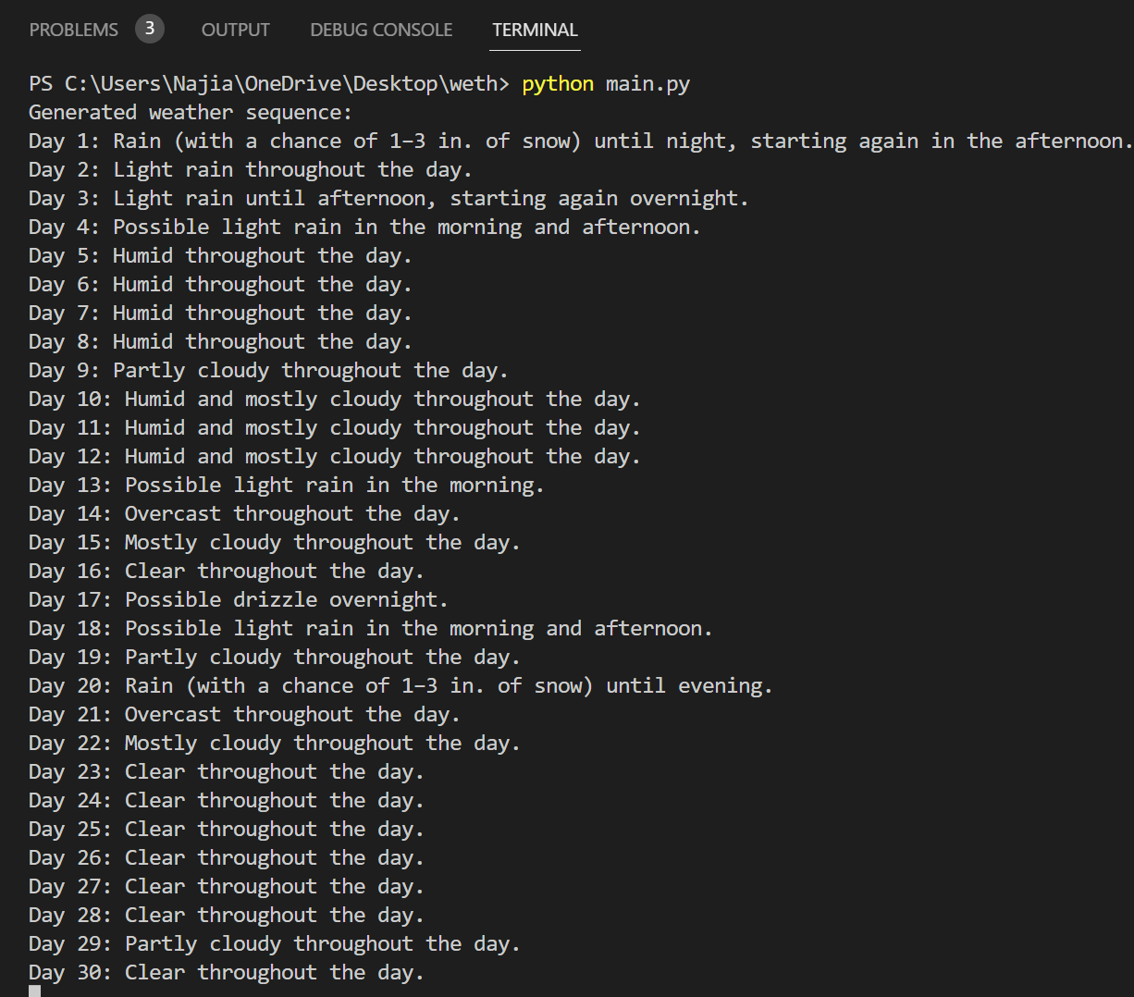
Terminal Output:

Slide 16
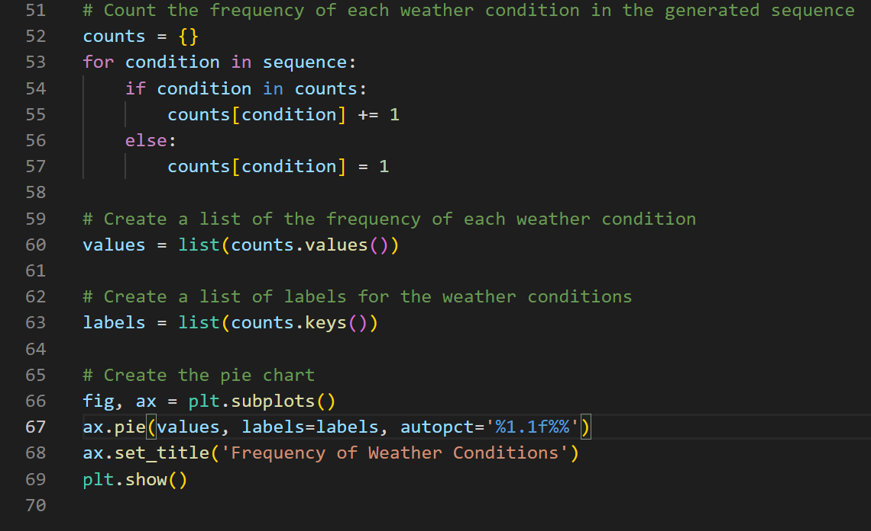

Slide 17
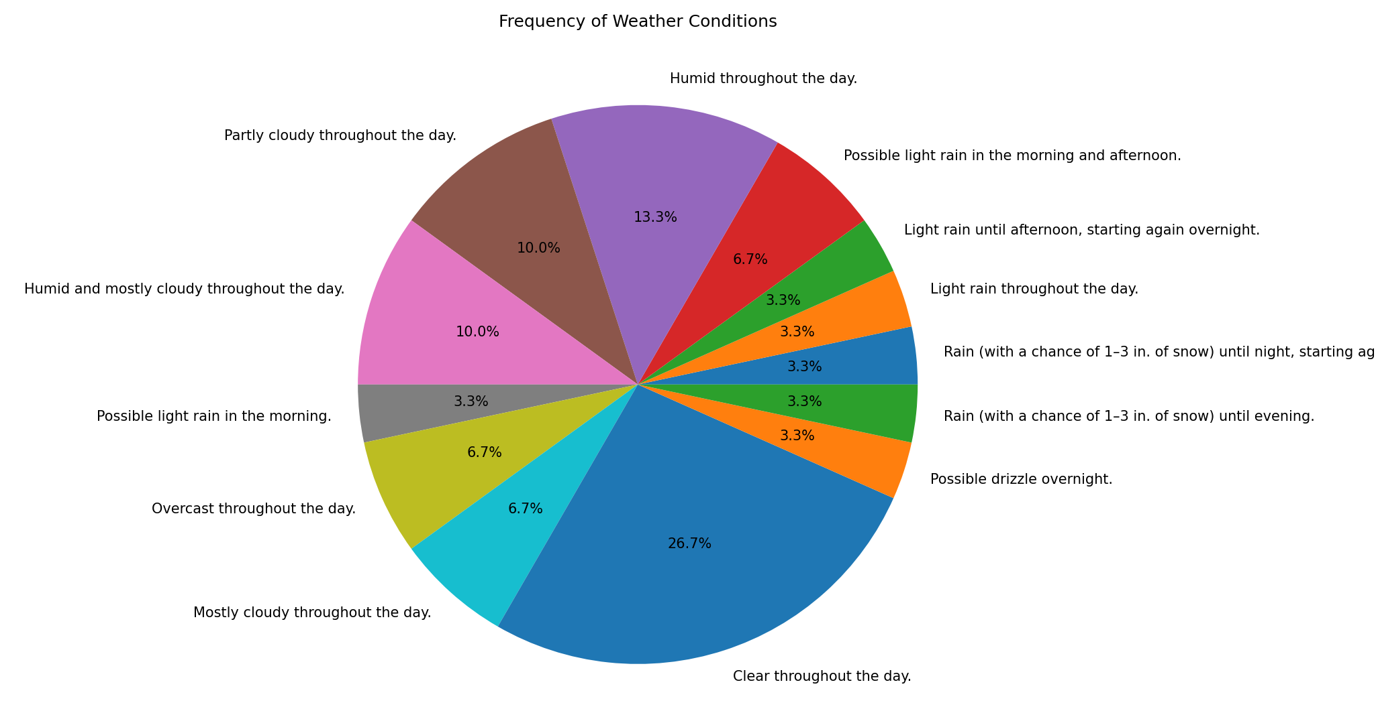

Slide 18


Slide 19
References
https://setosa.io/ev/markov-chains/
https://youtu.be/i3AkTO9HLXo
https://en.wikipedia.org/wiki/Markov_chain#:~:text=A%20Markov%20chain%20or%20Markov,the%20state%20of%20affairs%20now.%22

